Slide 1
Preliminary results CONVENTIONAL rotation E26 (2018-2022) Plot 1
03/10/2024

Slide 2
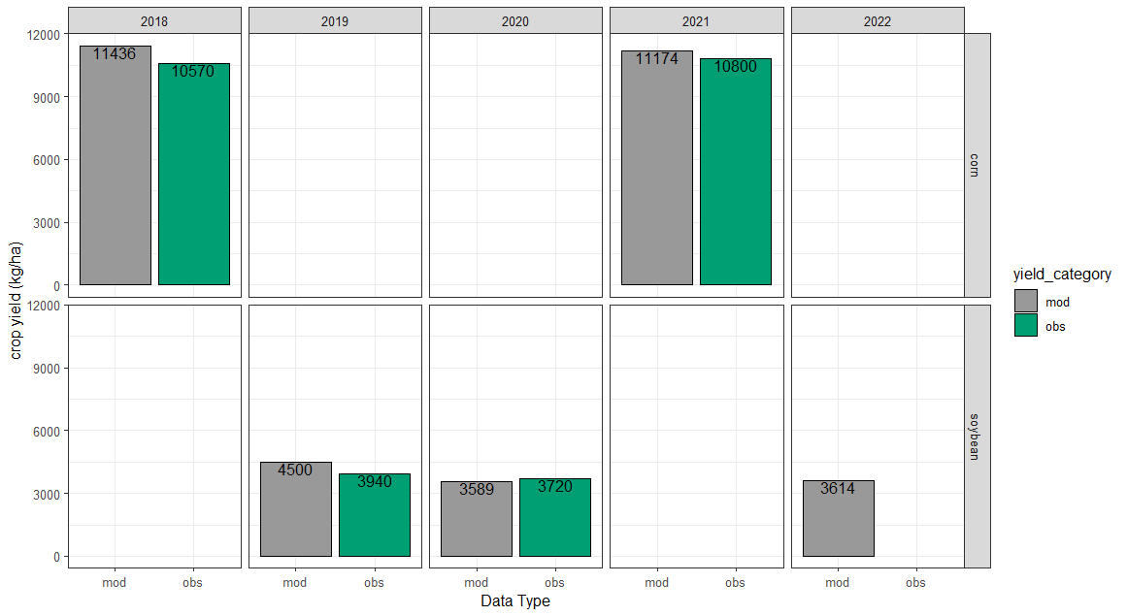
corn
corn
soybeans
soybeans
soybeans

Slide 3
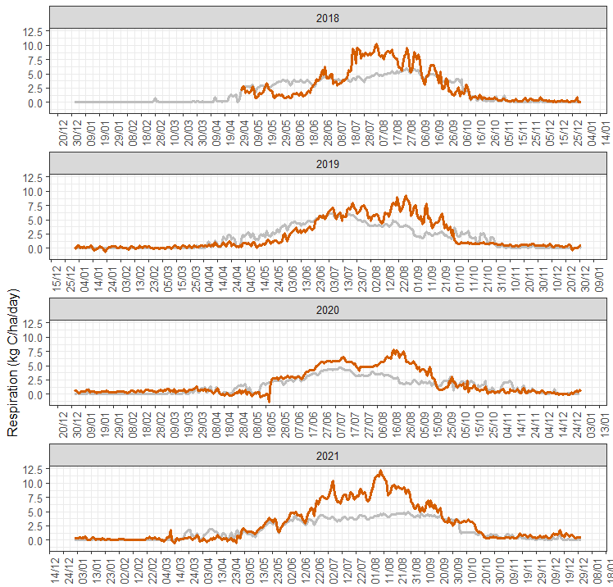
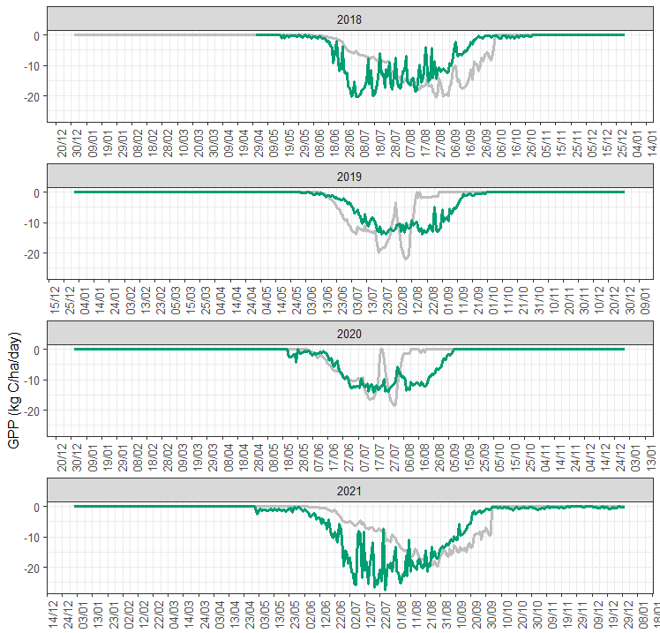
corn
corn
soybeans
soybeans
soybeans
soybeans
corn
corn

Slide 4
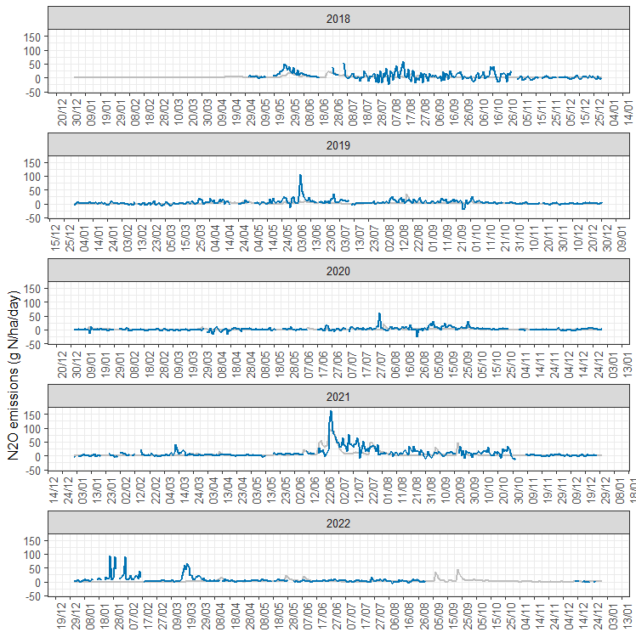

Slide 5
Preliminary results DIVERSE rotation E26 (2018-2022)
Plot 3
10/10/2024

Slide 6
Measured cover crop biomass Elora E26 (2018-2021)

Slide 7
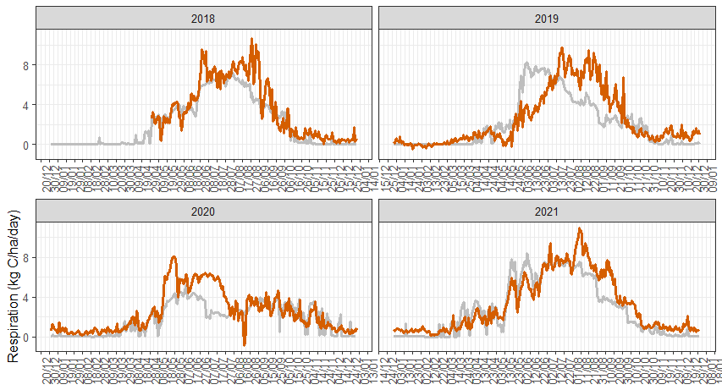
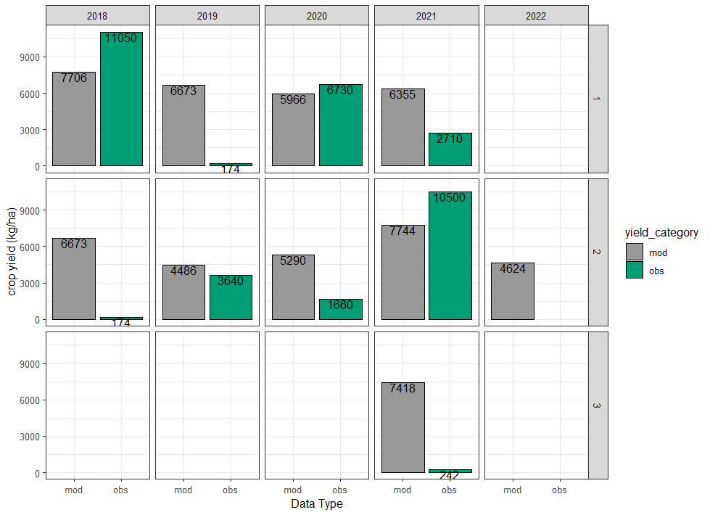
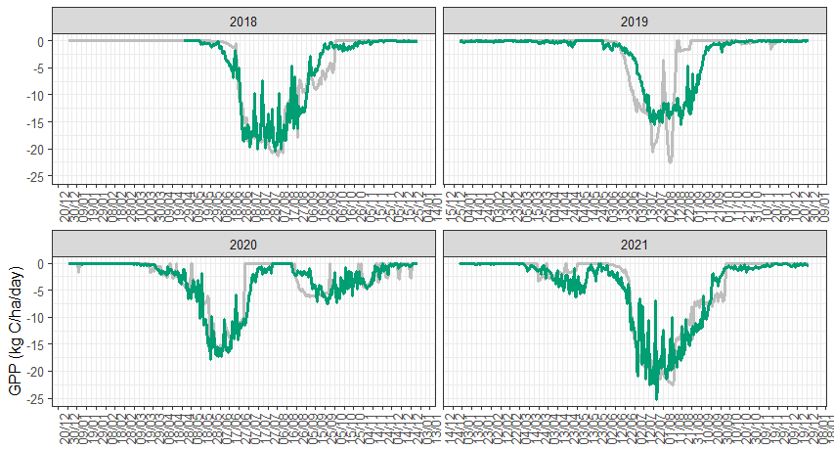
Using DNDC default values for cover crops, plus calibration from conventional rotation for other crops
2-cc spring
ww
4-cc spring
corn
2-cc fall
soybeans
4-cc fall
corn
2-cc fall
There seems to be a big mismatch in cover crop biomass, particularly for the 2-species cover crop; however, results for respiration and GPP do not look terrible

Slide 8
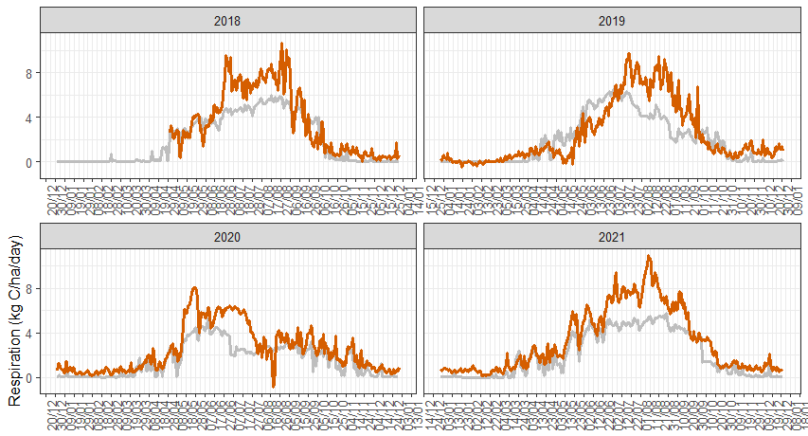
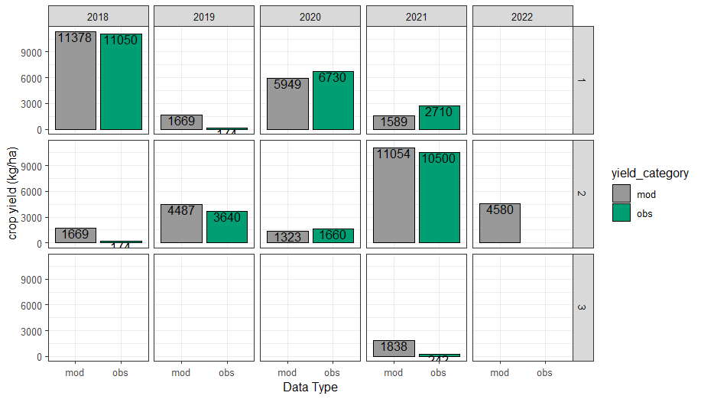

Default cover crop option from DNDC + max grain biomass = 10
2-cc
ww
4-cc
corn
2-cc
soybeans
4-cc
corn
2-cc
Cover crop and cash crop yields comparisons seem to get closer for simulated and observed, but respiration and GPP actually show worse alignment that in the scenario from the previous slide.

Slide 9

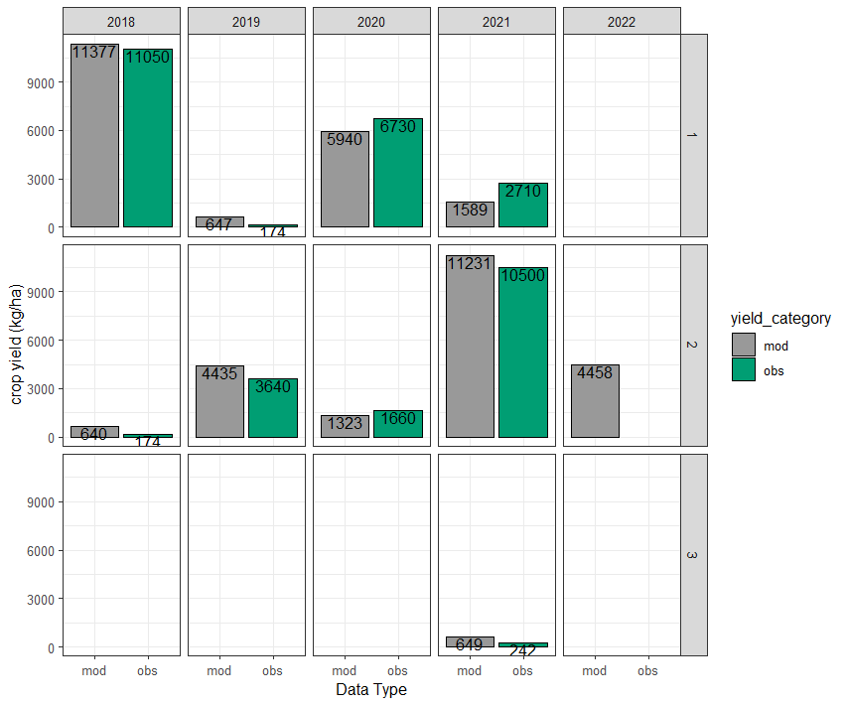

Default cereal rye from DNDC for 2CC + default cover crop for 4CC with maximum biomass = 10
2-cc
ww
4-cc
corn
2-cc
soybeans
4-cc
corn
2-cc

Slide 10

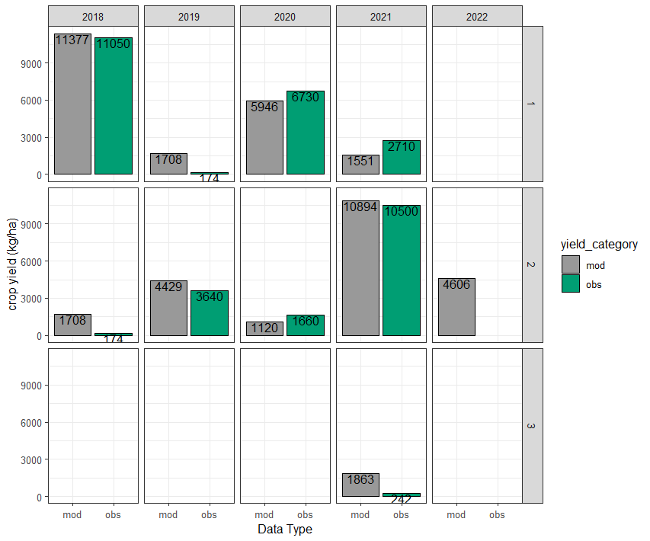

Set up from Brian’s file for cover crops (long term file for Elora)
2-cc
ww
4-cc
corn
2-cc
soybeans
4-cc
corn
2-cc

